Slide 1

Promoting mental health literacy among pupils
Come4Global –project 2023

Slide 2

Backround
WHO (2005)has stated the poor public knowledge about mental disorder in children and adolescent as one of the most critical challengies of mental health care in worldwide
  Evident specially in LMICs due the population of children with mental health issues
Mental health related knowledge, recognition and attitudes is crucial to mental health promotion, early identification/prevention and intervention

Slide 3
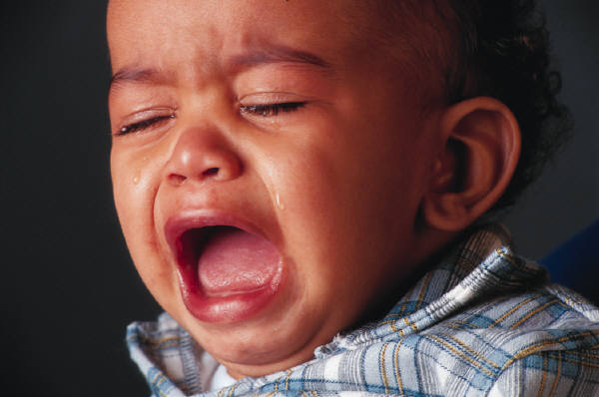
Introduction
“ Positive” as a character of the concept that makes it greater than freedom or absence of disorders or symptoms
Protective buffer for various life situations!
Resilience helps us to spring back from and cope in psychologically demanding situations
Social factors are strongly related to recovering mental health
Poor awareness and knowledge and strong attitudes towards mental health issues are widely globally recognized
  Cultural context matters
  Mental health literacy (MHL)
POSITIVE MENTAL HEALTH

Slide 4
Health Literacy (HL) - strong predictor of prosperity
European study showed significant determinants for poor HL as low socio-economical status and lower education
“ worse health and thus higher demands for health services seems to be accompanied by lower levels of health literacy” (Sørensen et al. 2019)
i.e overeating, alcohol consumption, and smoking to as coping mechanisms (Delara 2015)
WHO states that HL predicts economic prosperity
Literate individuals participate and are more successful
Worse socioeconomic status may increase social limitation (Delara 2015)
Sørensen et al. 2019.Health literacy in Europe: comparative results of the European health literacy survey (HLS-EU)

Slide 5
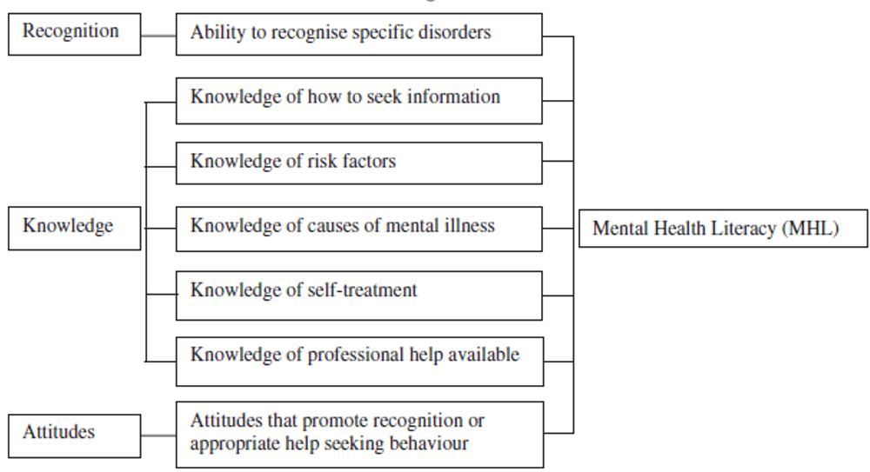
MHL has transformed over the years as a concept
MENTAL HEALTH LITERACY
”a foundation for mental health promotion, effective acknowledgment of prevention of mental disorders, and provision of evidence-based mental health care”
(Kutcher et al. 2016)
Recognition and knowledge on
maintaining positive mental health,
mental disorders and their treatments;
decreasing stigma;
enhancing help-seeking efficacy
(Jorm 1997, Kutcher 2016b)
Atttributes of MHL: O'Connor, M., Casey, L. & Clough, B. 2014, "Measuring mental health literacy--a review of scale-based measures", Journal of mental health (Abingdon, England), vol. 23, no. 4, pp. 197-204.

Slide 6

HOW to promote MHL among pupils
As half of all mental health conditions start by 14 years of age, MHL training should already start in schools
School is the place where mental health can be promoted (Sakellari et al., 2021 )​
A school mental health literacy curriculum resource training approach (Kutcher et al 2016) in Africa
  The use of a classroom-based resource guide that integrates MHL into existing school curriculum through training teachers may be an effective and sustainable way to increase the MHL (improved knowledge, decreased stigma and positive help-seeking efficacy) of teachers

Slide 7
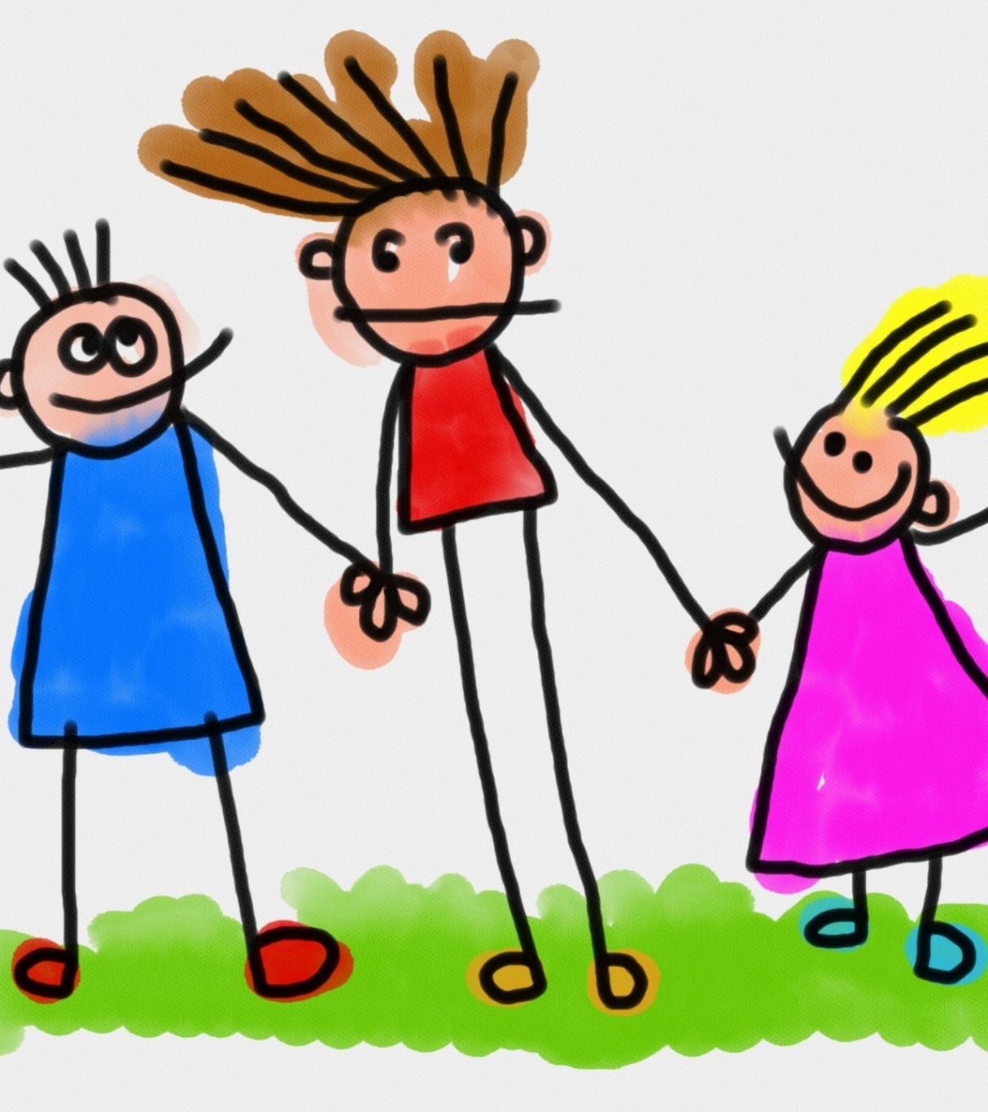
Personalized education has more effect on chronic disease than multimedia interventions with no personalized contact. (WHO 2013):
Still, the most people seek out supplementary information from several mass-media sources
Social media and mobile health transform as great strategy for health care originations to improve health literacy,
  Evidence on mental health interventions using digital methods in primary school settings is limited (Sakellari et al., 2021)
  Threats may apply as social media pose higher risks than i.e print mendia ->needs to be monitored and moderated!

Slide 8
Studies highlight the use of online technologies among youth as a promising method to increase access to evidence-based mental health resources (Sakellari et al., 2021 )​
Whole school -approach with digital interventions supports positive mental
health (O’Reilly et al.,2018)​
Even though it is teachers' MHL that can be decisive in improving the well-being of pupils (Kutcher et al, 2016), many development projects suffer from low participant motivation (Sakellari et al., 2021)
Anttila et al., 2021​
Several digital methods may foster positive mental health and mental health literacy​
Gamification,interactive exercises/modules, videos/animations, social media/messaging, and chatbots have all shown promise in mental health improvement.
PARENTS’ MHL: A review study indicated limited number of studies that evaluated effects of MHL program in parents, having poor methodological quality (Kusaka et al, 2022)

Slide 9
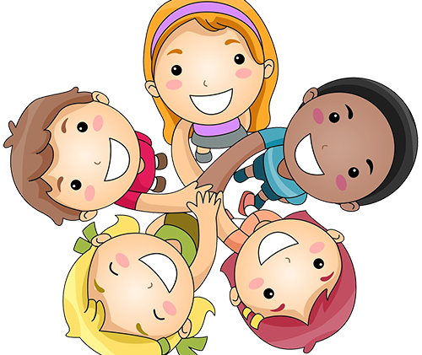
Obstacles and barriers noted
Programmes/interventions promoting MHL in adolescents in school settings lack assessment tools for attribute of knowledge about achieving and maintaining good mental health (Nobre et al, 2022):
Missing health professionals
The main barrier noticed is the difficulty of coordination with different school stakeholders; the interruption of school curricula, and the lack of incentives for participants
This Photo by Unknown Author is licensed under CC BY-NC

Slide 10
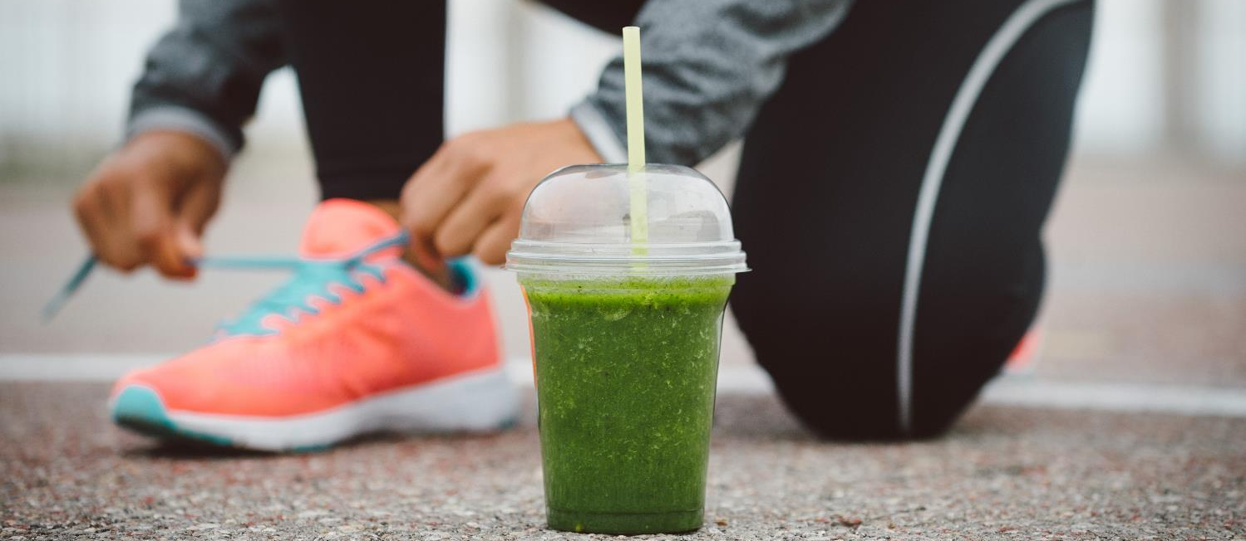
Good mental health infrastructure in smart society
  Web-based interventions may promote recognition of mental health issues and help seeking possibilities for pupils
  (Gigantesco et al. 2019)

Slide 11
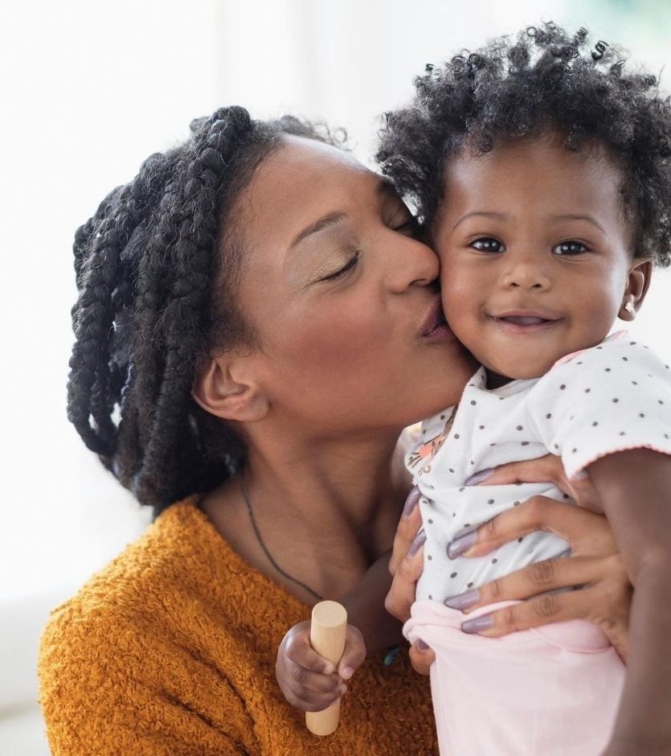
Conclusion
Poor MHL is a global concern
Rotary of MHL: focusing teacher’s MHLS in promotive actions?
Linking schools and primary health care clinics is crucial in promoting child and adolescents MHL
Innovation processes are urgent for finding cost-effective solutions within mental health services
  -> Not to forget the cultural context and enviroment in conducting promotive actions
Notes:
Issues due the poor MHL are universal

Slide 12
REFERENCE
Delara M, "Social Determinants of Immigrant Women’s Mental Health", Advances in Public Health, vol. 2016, Article ID 9730162, 11 pages, 2016. https://doi.org/10.1155/2016/9730162
Kusaka, S., Yamaguchi, S., Foo, J. C., Togo, F., & Sasaki, T. (2022). Mental Health Literacy Programs for Parents of Adolescents: A Systematic Review. Frontiers in psychiatry, 13, 816508. https://doi.org/10.3389/fpsyt.2022.816508
Kutcher S,Wei Y, & Hashish M. 2016.- Chapter 8 - Mental Health Literacy for Students and Teachers: A “School Friendly” Approach, Editor(s): Matthew Hodes, Susan Gau,Positive Mental Health, Fighting Stigma and Promoting Resiliency for Children and Adolescents, Academic Press,2016, P. 161-172, ISBN 9780128043943, https://doi.org/10.1016/B978-0-12-804394-3.00008-5.
Kutcher, S., Wei, Y., Gilberds, H., Ubuguyu, O., Njau, T., Brown, A., … Perkins, K. (2016). A school mental health literacy curriculum resource training approach: effects on Tanzanian teachers' mental health knowledge, stigma and help-seeking efficacy. International journal of mental health systems, 10, 50. doi:10.1186/s13033-016-0082-6
Kutcher S, Wei Y, Coniglio C. Mental Health Literacy: Past, Present, and Future. The Canadian Journal of Psychiatry. 2016;61(3):154-158. doi:10.1177/0706743715616609
Nobre, J., Oliveira, A. P., Monteiro, F., Sequeira, C., & Ferré-Grau, C. (2021). Promotion of Mental Health Literacy in Adolescents: A Scoping Review. International journal of environmental research and public health, 18(18), 9500. https://doi.org/10.3390/ijerph18189500

Slide 13
Anttila, M., Lantta, T., Ylitalo, M., Kurki, M., Kuuskorpi, M., & Välimäki, M. (2021). Impact and Feasibility of Information Technology to Support Adolescent Well-Being and Mental Health at School: A Quasi-Experimental Study. Journal of multidisciplinary healthcare, 14, 1741–1753. https://doi.org/10.2147/JMDH.S311788 ​
Gigantesco, A., Palumbo, G., Zadworna-Cies´lak, M., Cascavilla, I., Del Re, D., Kossakowska, K. and WST European Group* 2019. An international study of middle school students’ preferences about digital interactive education activities for promoting psychological well-being and mental health. Ann Ist Super Sanità 2019 | Vol. 55, No. 2: 108-117 DOI: 10.4415/ANN_19_02_02 An international study of middle school_ANN_19_02_02.pdf​
Markkanen P. 2021. Supporting pupils’ mental health in schools. Teaching staff’s and school nurses’ perceptions and the suitability of a webbased support system for pupils. Turun yliopiston julkaisua - Annales Universitatis Turkuensis, Ser. D: Medica-Odongologica. Available from: https://urn.fi/URN:ISBN:978-951-29-8695-8​
O’Reilly, M., Svirydzenka, N., Adams, S. et al. Review of mental health promotion interventions in schools. Soc Psychiatry Psychiatr Epidemiol 53, 647–662 (2018). https://doi.org/10.1007/s00127-018-1530-1​
Sakellari, E., Notara, V., Lagiou, A., Fatkulina, N., Ivanova, S., Korhonen, J., Kregar Velikonja, N., Lalova, V., Laaksonen, C., Petrova, G., & Lahti, M. (2021). Mental Health and Wellbeing at Schools: Health Promotion in Primary Schools with the Use of Digital Methods. Children (Basel, Switzerland), 8(5), 345. https://doi.org/10.3390/children8050345​

Slide 14
Kiitos
Thank you! Grazie! Tack! Shukran! Merci! Danke! Dank U! Paldies! Takk! Gracias! Efharisto! спасибо! Hvala! Dziękuję! Obrigado! Aitäh! Tak! Köszönöm! Sağol! хвала! Ačiū! Děkuji! Mulțumesc!谢谢! благодаря! Cảm ơn bạn! 고맙습니다!

